Slide 1
Syntax-prosody mapping in clausal domains: right dislocation in Mandarin and Cantonese
PhEx 10 The University of Tokyo 2020-2-15
Ka-Fai Yip, The Chinese University of Hong Kong kafaiyip@cuhk.edu.hk

Slide 2
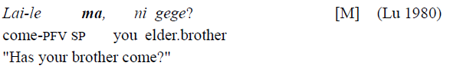
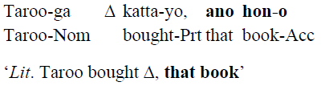
Right dislocation (RD)
RD is a construction where a string is dislocated to the right of a sentence, leading to an abnormal sentence-medial position of the sentence particles (SPs) (Cheung 2009).
Chinese: S-V-SP → V-SP-S (subject RD)
Japanese: S-O-V-SP → S-V-SP-O (object RD)

Slide 3
A puzzle on syntax-prosody mapping
Given that SPs are often at sentence-final position, does the main chunk form a sentence, in the sense of syntax (i.e. CP) and prosody (i.e. intonational phrase)?
What is the status of RD chunk?
Serve as a testing ground on one-to-one mapping of syntax and prosody in clausal domains (as proposed by Feng 2015, 2017).
main chunk
right-dislocated chunk

Slide 4
Prosodic phrasing: (Cheng & Downing 2012) Spell-out domain-based vs. phase edge-based [_{CP} C [_{TP} … ]] [_{CP} C [_{TP} … ] ] ( ) ( ) intonational phrase
Given that SPs are C-heads (or heads of split C)…
Spell-out domain-based: predict SPs to be outside the ι-phrase → (main chunk-SP) (RD chunk)
Phase edge-based: predict SPs to be inside the ι-phrase → (main chunk-SP RD chunk)
Boundary tones constitute crucial evidence for ι-phrase boundaries
How would boundary tones (intonation) be realized in RD?

Slide 5
Why Cantonese? Why Mandarin?
Cantonese has rich boundary tones on the final syllable of an ι-phrase (Wong 2005, B. Xu & Mok 2011, Han 2013).
Could be analyzed as segmentless SPs (Tang 2006, 2020, Zhang 2014, Ki 2019, Lau 2019).
Mandarin’s question intonation differs from Cantonese in using global raising (Lee 2005, Liu & Y. Xu 2005).
Involves change in pitch of the whole sentence body.
Is used as a perceptional clue (Yang 2018).

Slide 6
Roadmap
§2: RD as one CP literature
§3: RD as one intonational phrase acoustic experiment
§4: Intonation in RD acoustic experiment
§5: Prediction on variation of RD native judgement and natural data

Slide 7
§2: RD as one CP

Slide 8
Competing approaches on RD
Monoclausal movement approach (Cheung 2009)
[_{FocP} Lai-le [_{CP} ma, [_{TP} ni gege __ ]]] ? come-pfv sp you elder.brother "Has your brother come?"
Biclausal deletion approach (Shi 2002)
[_{CP} ni gege lai-le ma] [_{CP} ni gege lai-le ma]?

Slide 9
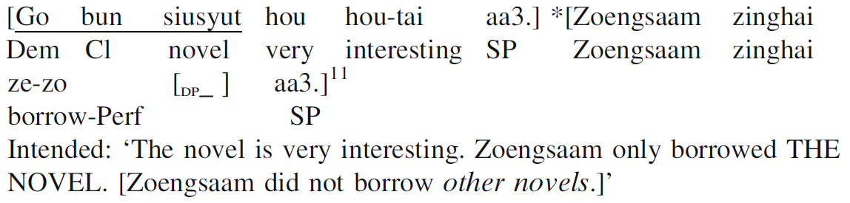
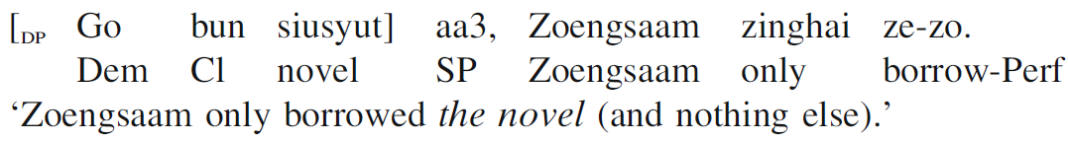
RD as one CP
Cheung (2009):
SPs (presumably C) cannot occur twice
*Lai-le ma, ni gege ma? [M] come-pfv sp you elder.brother sp
Connectivity effects
Association of “only” and focus [C]

Slide 10
§3: RD as one intonational phrase

Slide 11
Experiment one: design
Trichotomy: (all are declaratives)
(1) Non-RD (one sentence) [S-V-O-SP]
(2) Non-RD (two sentences) [S-V-O-SP] [S-V-O-SP]
(3) RD [V-O-SP-S]
Cantonese:
7 syllables in tone 3 (mid-level, 33)
E.g. sung3 zi3 heoi3 gwo3 taai3 gwok3 gaa3. 宋智去過泰國架 Sungzi go perf Thailand SP “Sungzi had a trip in Thailand.”
Subjects: 3 female, 3 male (19-22) speaking Hong Kong Cantonese
3 types x 3 sets of lexical items x 3 repetition x 6 subjects = 162 tokens

Slide 12
Mandarin:
6 syllables in tone 1 (high-level, 55) with 1 toneless SP (neutral tone)
E.g. zhōu qīng duō zhāi xiāng jiāo le. 周青多摘香蕉了 Zhouqing more pick banana SP “Zhouqing took more banana than allowed.”
Subjects: 2 female, 2 male (19-24) speaking Northern Mandarin
3 types x 3 sets of lexical items x 3 repetition x 4 subjects = 108 tokens
Target-filler ratio is approximately 1:1.7.
Processed by ProsodyPro (Xu 2013) to get time-normalized F0 (10 time points per syllable) and average across speakers

Slide 13
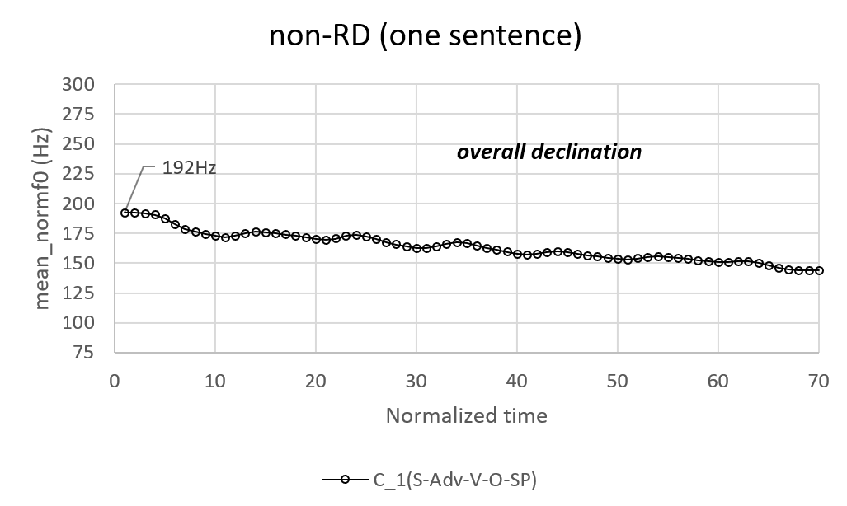
Experiment one: results (Cantonese)

Slide 14
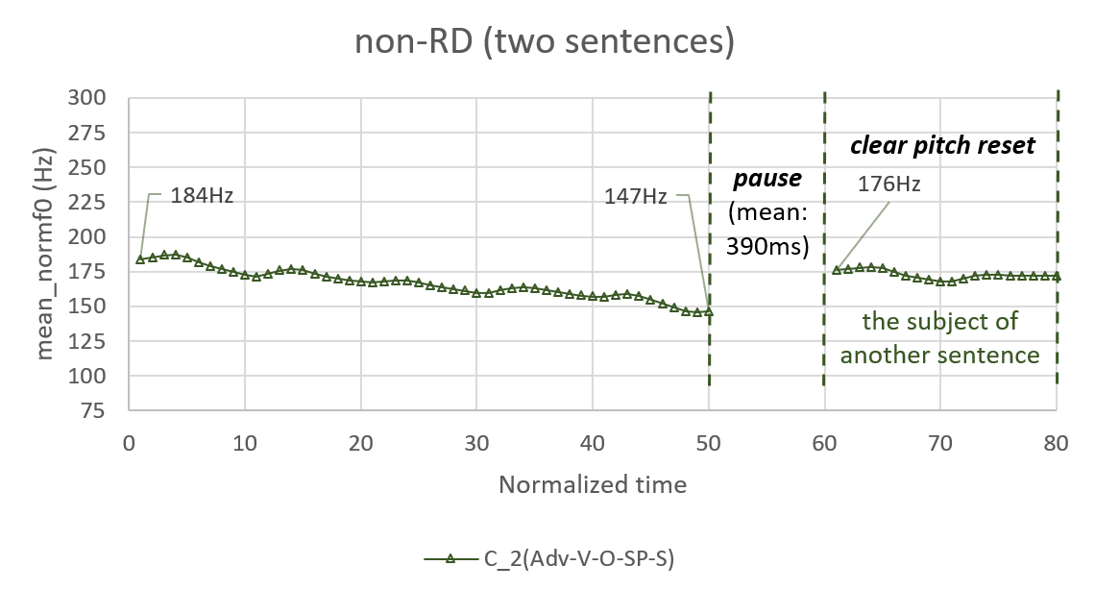

Slide 15


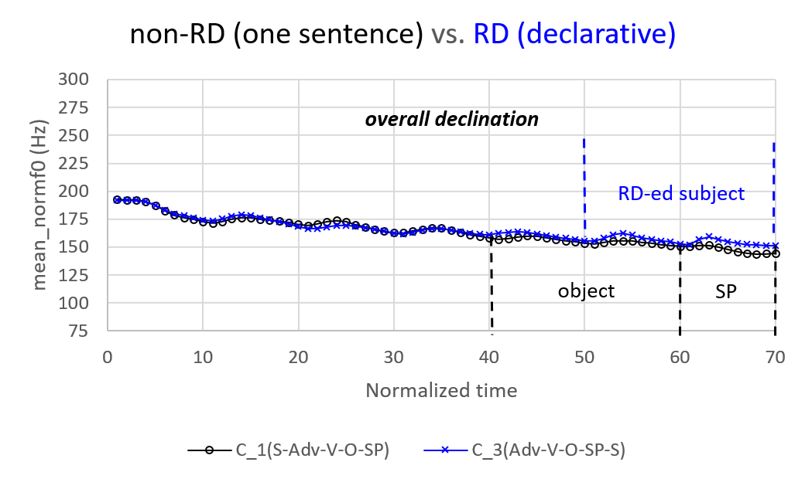
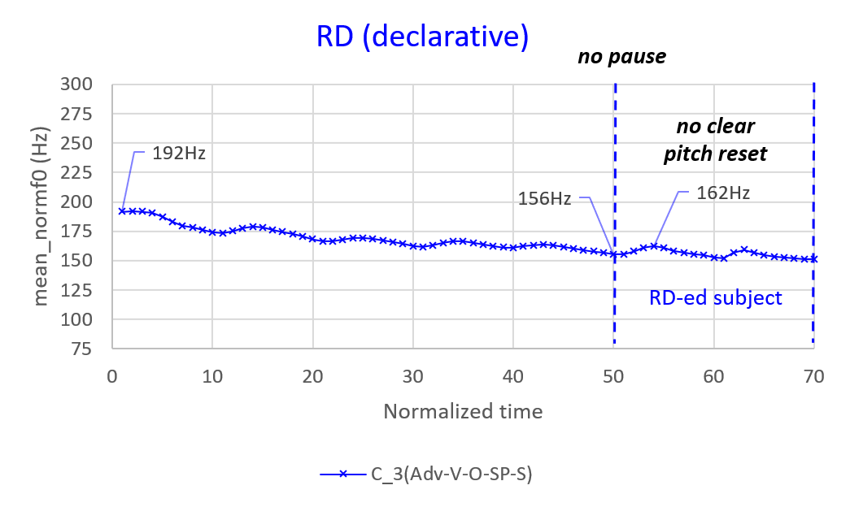

Slide 16
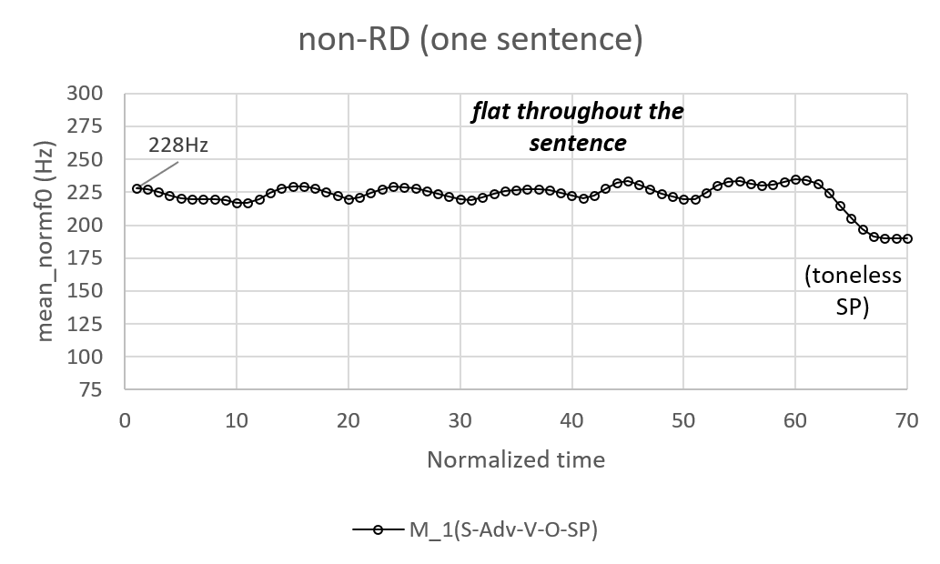
Experiment one: results (Mandarin)

Slide 17
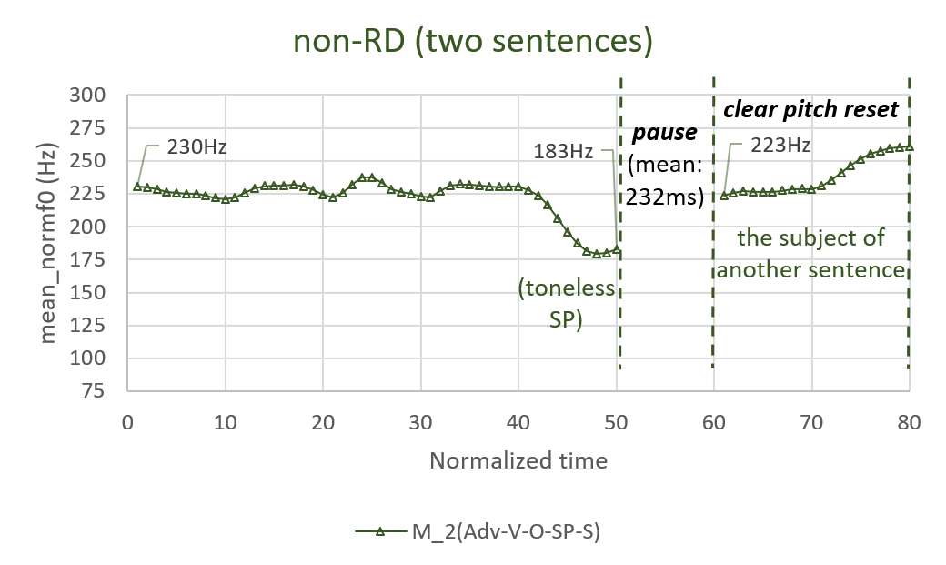

Slide 18
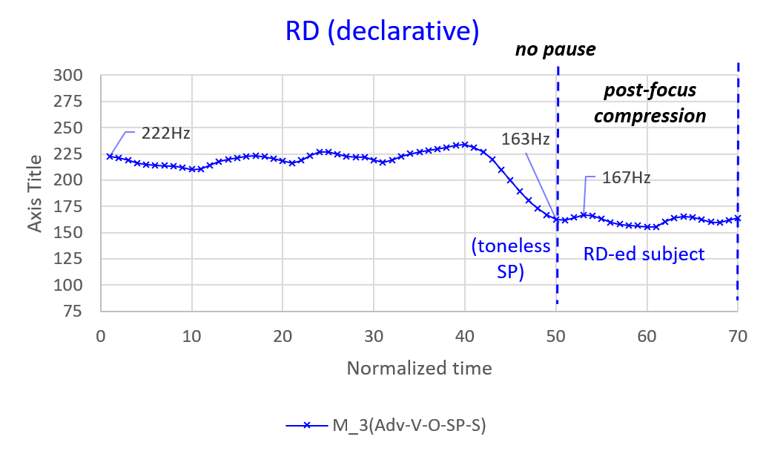

Slide 19
Experiment one: discussion
→ main chunk and RD chunk belong to the same prosodic domain, namely intonational phrase → RD is one intonational phrase (main chunk-SP RD chunk %)
(3) RD | Cantonese | Mandarin
Pause before RD chunk | NO | NO
Pitch reset of RD chunk | NO | NO
Overall declination | YES | Not applicable
Post-focus compression of RD chunk | Not applicable | YES

Slide 20
§4: Intonation in RD

Slide 21
What do we expect?
Knowing that RD is an intonational phrase…
Cantonese uses a final rising boundary tone H% to express yes-no questions (Xu & Mok 2011, Zhang 2014).
→ Expect to occur at the last syllable of the RD chunk (main chunk RD chunk H% )
Mandarin employs global raising in yes-no questions (Liu & Y. Xu 2005, B. Xu & Mok 2011).
→ Expect to behave just as the same with non-RD (i.e. increase in pitch of each syllable)

Slide 22
Experiment two: design
Dichotomy (with control sentences):
(1) Control: non-RD with a question particle [S-V-O-QP]?
(2) Target: RD with a question particle [V-O-QP-S]?
(3) Control: non-RD with question intonation [S-V-O]?
(4) Target: RD with question intonation [V-O-S]?
Cantonese:
7 syllables (6 syllables for (3)(4)) in tone 3 (mid-level, 33)
E.g. sung3 zi3 heoi3 gwo3 taai3 gwok3 maa3? 宋智去過泰國嗎? Sungzi go perf Thailand QP “Did Sungzi go to Thailand?”
Subjects: 3 female, 3 male (19-22) speaking Hong Kong Cantonese
4 types x 3 sets of lexical items x 3 repetition x 6 subjects = 216 tokens

Slide 23
Mandarin:
6 syllables in tone 1 (high-level, 55), with 1 toneless QP (neutral tone) for (1),(2).
E.g. zhōu qīng duō zhāi xiāng jiāo ma? 周青多摘香蕉嗎? Zhouqing more pick banana QP “Did Zhouqing take more banana than allowed?”
Subjects: 2 female, 2 male (19-24) speaking Northern Mandarin
4 types x 3 sets of lexical items x 3 repetition x 4 subjects = 144 tokens
Target-filler ratio is approximately 1:2.
Processed by ProsodyPro (Xu 2013) to get time-normalized F0 (10 time points per syllable) and average across speakers

Slide 24
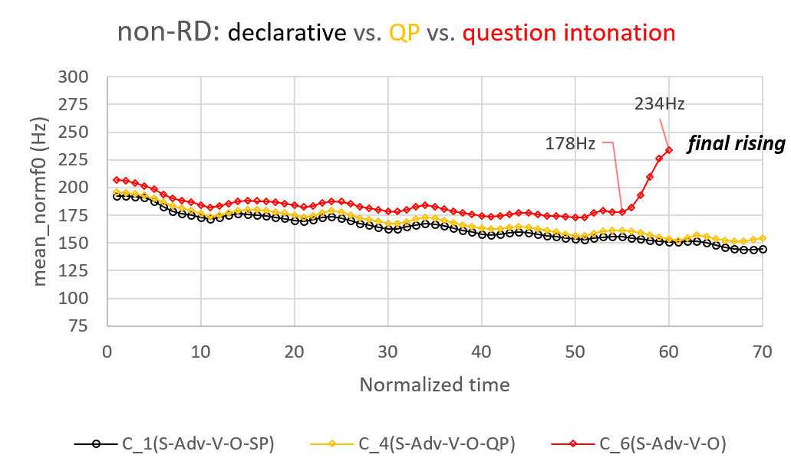
Experiment two: results (Cantonese)

Slide 25
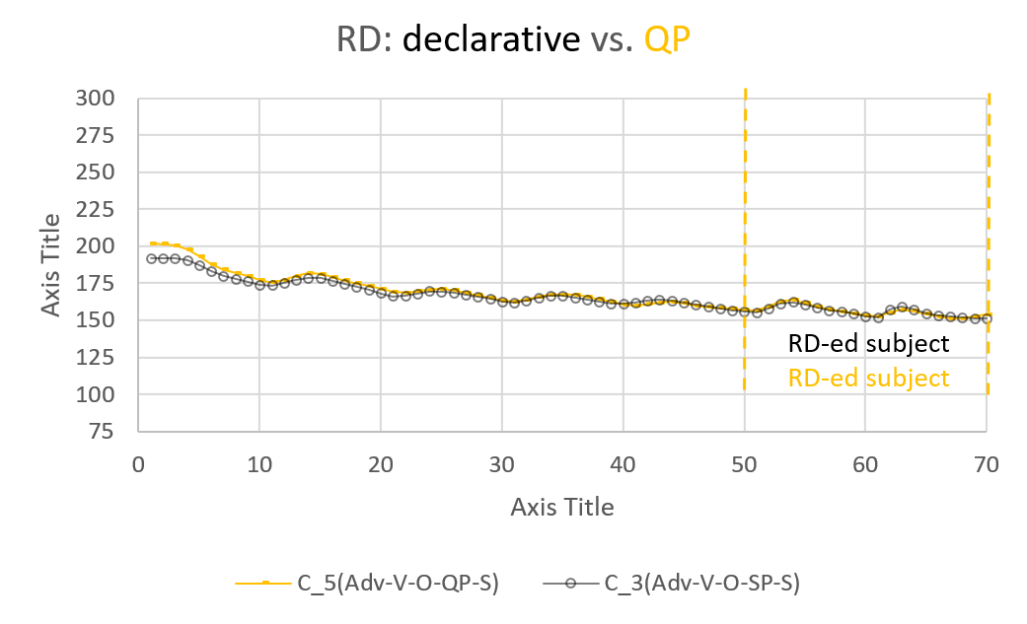

Slide 26
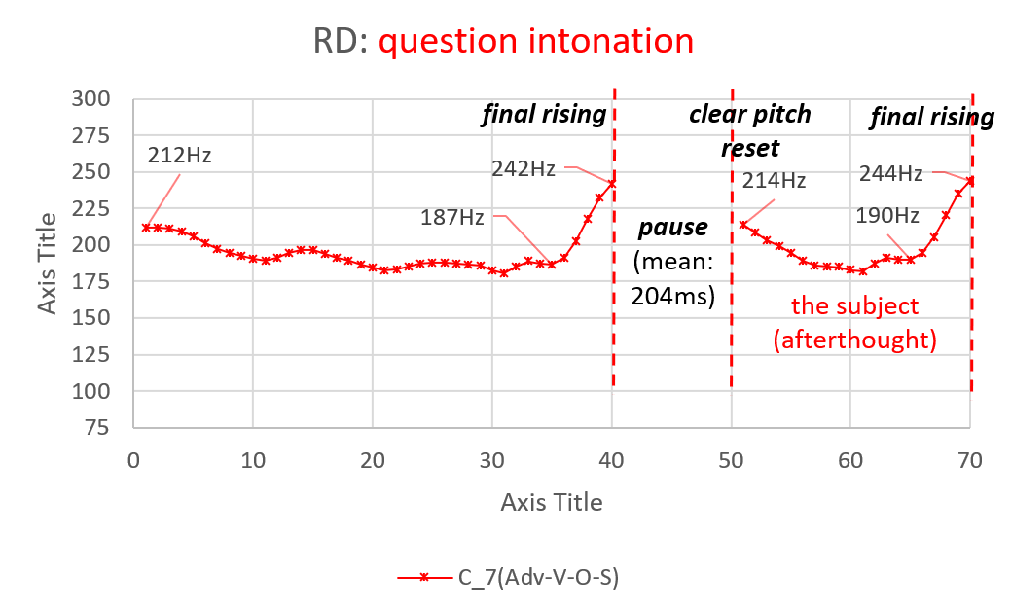
(! Not what we expected!)

Slide 27
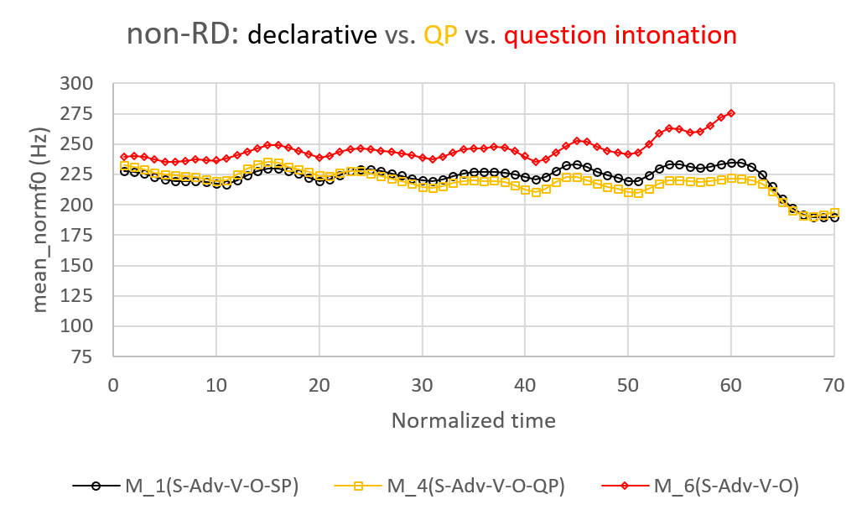
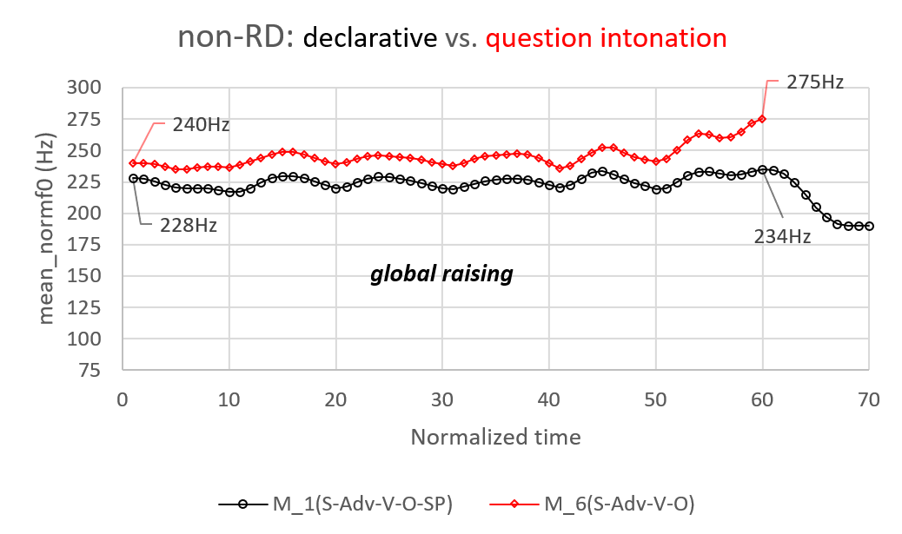
Experiment two: results (Mandarin)

Slide 28
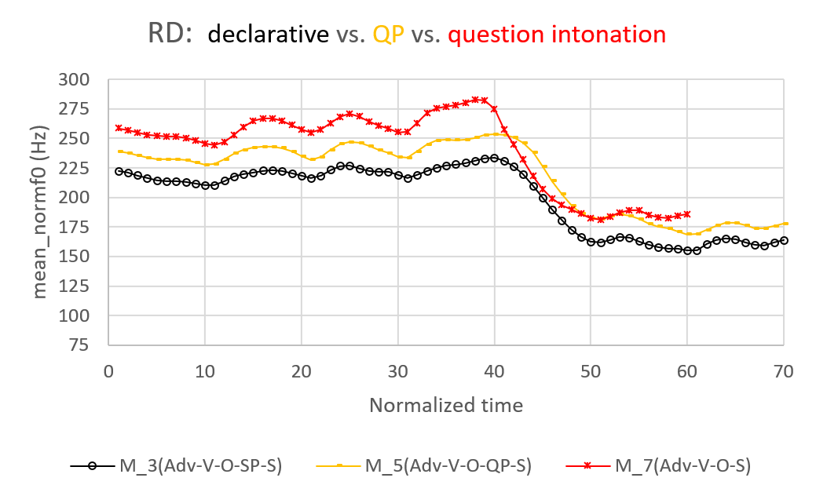
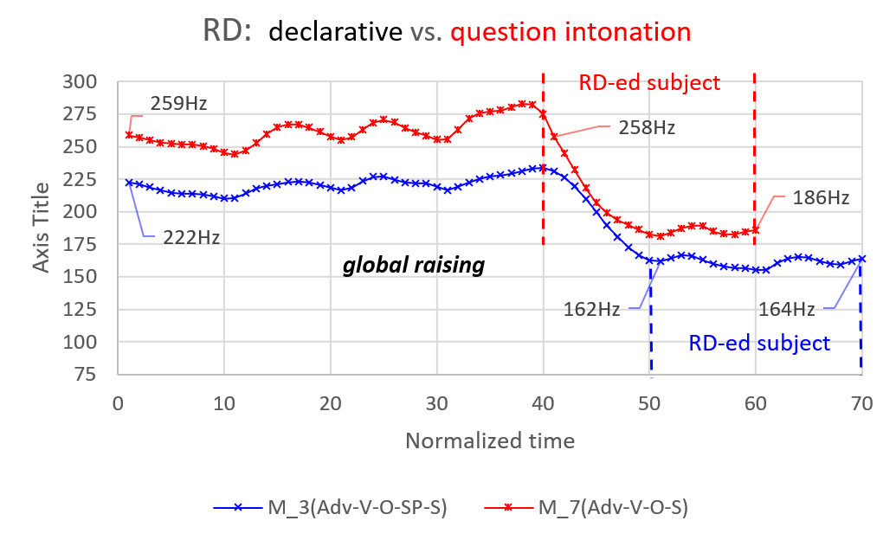

Slide 29
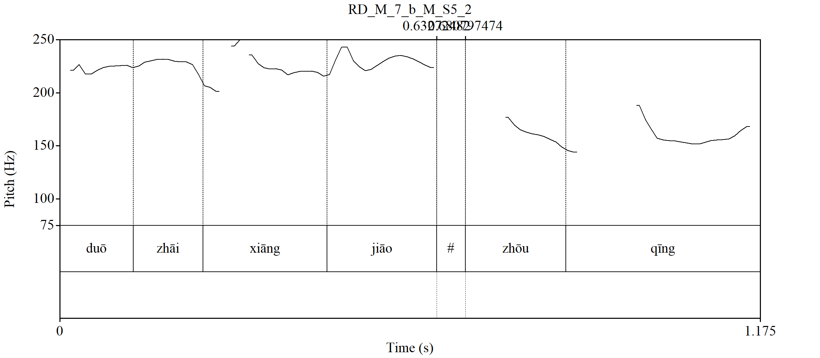
One of the subjects prefer a short pause. Long pause is not acceptable.
50ms

Slide 30
Experiment two: discussion
The question intonation in Mandarin can occur in RD.
Cantonese H% realized at both main chunk and RD chunk.
→ become two ι-phrases → not RD but afterthought: carries different discourse function e.g. contrastive focus (Li & Wei 2017)
 | Cantonese |  | Mandarin
 | (5)RDQP | (7)RDintonation | (5) RDQP | (7)RDintonation
Pause before RD chunk | NO | YES | NO | YES/NO
Pitch reset of RD chunk | NO | YES | NO | NO
Overall declination | YES | NO | Not applicable
Final rising of RD chunk | NO | YES (but also main chunk) | Not applicable
PFC of RD chunk | Not applicable |  | YES | YES
Global raising | Not applicable |  | NO? | YES

Slide 31
To realize H% in RD:
i. (main chunk H% RD chunk) → * (not boundary) *heoi3 gwo3 taai3 gwok3 H% sung3 zi3? go perf Thailand Sungzi
ii. (main chunk H%) (RD chunk H%) → OK heoi3 gwo3 taai3 gwok3 H% sung3 zi3 H%? go perf Thailand Sungzi
iii. (main chunk RD chunk H%) → * (unexpected) heoi3 gwo3 taai3 gwok3 sung3 zi3 H%? go perf Thailand Sungzi

Slide 32
A syntactic explanation to (iii):
H% shows complementary distribution with question particles → can be treated as a segmentless SP (Tang 2006, Zhang 2014) → presumably also C-head
[_{FocP} went to Thailand [_{CP} C-H% [_{TP} Sungzi _ ]]]
Upon linearization: *(went to Thailand H% Sungzi) → ruled out by prosodic restriction on boundary tones
To derive (went to Thailand Sungzi H% ), C must be lowered to TP: *[_{FocP} went to Thailand [_{CP} __ [_{TP} Sungzi-C-H% _ ]]]
Not possible!

Slide 33
The fourth possibility?
iv. (main chunk RD chunk) → * (no clue for question reading) heoi3 gwo3 taai3 gwok3 sung3 zi3? go perf Thailand Sungzi
Disallowed by Clause Typing Hypothesis (Cheng 1991)
But … (iv) is also deviated in a declarative reading.
Why?

Slide 34
§5: Prediction on variation of RD

Slide 35
Predicting requirement of RD on SPs
Two assumptions:
a. Assume that intonation carrying discourse/ syntactic function is C-head. (Sybesma & Li 2007, Tang 2006, Zhang 2014)
b. Assume that C-head must be realized in either segmental or suprasegmental forms. (Feng 2013, 2015, 2017)
Cantonese boundary tones cannot realized in RD. (exp. 2) → Cantonese can only realize C as SPs in RD.
Mandarin may realize intonation globally, which can occur in RD (exp.2 ) → Mandarin could have SP-less RD.

Slide 36
SP requirement of Cantonese RD
SP-less RD:
Q: Did you eat the oranges? → Acceptable in Mandarin (Lu 1980:49) A: yi-ge ye meiyou chi, wo . 一個也沒有吃, 我 one-cl also neg.perf eat 1sg “I haven’t even eat one.” → Ungrammatical in Cantonese A: jat-go dou mou sik *(aa3), ngo 一個都冇食*(啊)我 one-cl also neg.perf eat sp 1sg
Also reported in Lai (2019) for dislocation copying, who derives this requirement by assuming null-C does not have a structure building feature.

Slide 37
Gains support from natural data: the movie Young and Dangerous 2 (1996, 101 mins)
Number of RD in the Cantonese version: 16
ALL of them carry SPs!
Tailou aa3 daaifei! 睇路啊大飛! watch.out sp Daaifei “Daaifei please be careful!”
Number of RD in the Mandarin version: 4
two of them are SP-less
Xiaoxin dian Dafei ! 小心點大飛! watch.out bit Daaifei “Daaifei please be careful!”

Slide 38
Concluding remarks

Slide 39
Concluding remarks
Right dislocation is one CP and is one intonational phrase. This lends support to the one-to-one mapping of syntax and prosody in clausal domains.
Also flavors a phase edge-based approach to mapping.
Variation of SP requirement of Cantonese and Mandarin RD can be attributed to their difference in the intonation systems.
How about right dislocation in Japanese and other languages? (especially its interaction with intonation systems)
What about dislocation copying? [S-V-O-SP-S] (Cheung 2015, Lai 2019)

Slide 40
Selected references
Cheung, L. Y. L. (2009). Dislocation focus construction in Chinese. Journal of East Asian Linguistics 18: 197–232.
Feng, S. (2015). Tone, intonation and sentence final particles in Chinese. Yuyanxue Luncong [Essays on linguistics] 51:52-59.
Feng, S. (2017). On grammatical effects on interactions between intonation, stress and syntax. Yuyan Jiaoxue yu Yanjiu [Language Teaching and Linguistic Studies] 3:1-17.
Lai, J. Y. K. (2019). Parallel copying in dislocation copying: evidence from Cantonese. Journal of East Asian Linguistics 28(3): 243-277.
Lee, O.J. (2005). The Prosody of Questions in Beijing Mandarin. Ph.D. Thesis, The Ohio State University.
Liu, F., and Xu, Y. (2005). Parallel encoding of focus and interrogative meaning in Mandarin intonation. Phonetica 62: 70–87.
Xu, B. R., and P. P.-K. Mok. (2011). Final rising and global raising in Cantonese intonation. Proceedings of the Seventeenth International Congress of the Phonetic Sciences: 2173–2176.
Xu, Y. (2013). ProsodyPro — A Tool for Large-scale Systematic Prosody Analysis. In Proceedings of Tools and Resources for the Analysis of Speech Prosody (TRASP 2013), Aix-en-Provence, France. 7-10.
Zhang, L. (2014). Segmentless sentence-final particles in Cantonese: An experimental study. Studies in Chinese Linguistics 35.2: 47-60.

Slide 41
Thank you!
Comments are welcome!
ありがとうございます。
どうぞ 宜しく お願いします。

